Slide 1
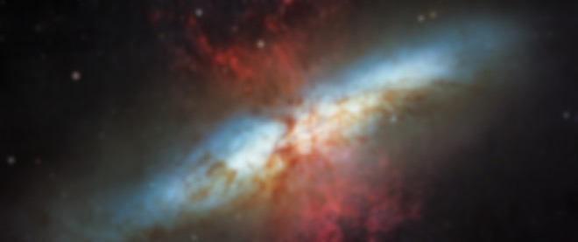
Predicting the Higgs-Boson signal
- A kaggle challenge
Diego de Lazarri | Linlin Chen | Danli Zeng

Slide 2
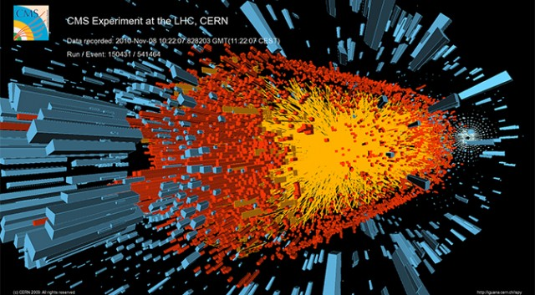
introduction
The Higgs boson was the last hold-out particle remaining hidden during the quest to check the accuracy of the Standard Model of Physics.
On March 14, 2013 CERN officially announced the confirmation of the Higgs boson.
The Kaggle competition is about trying to filter out signal from background noise using selected & simulated ATLAS experiment data

Slide 3
EDA AGGR MISSINGNESS
7 variables always missing
together
3 variables are missing only
when the other 7 variables
are missing
1 variable can be missing on
Its own

Slide 4
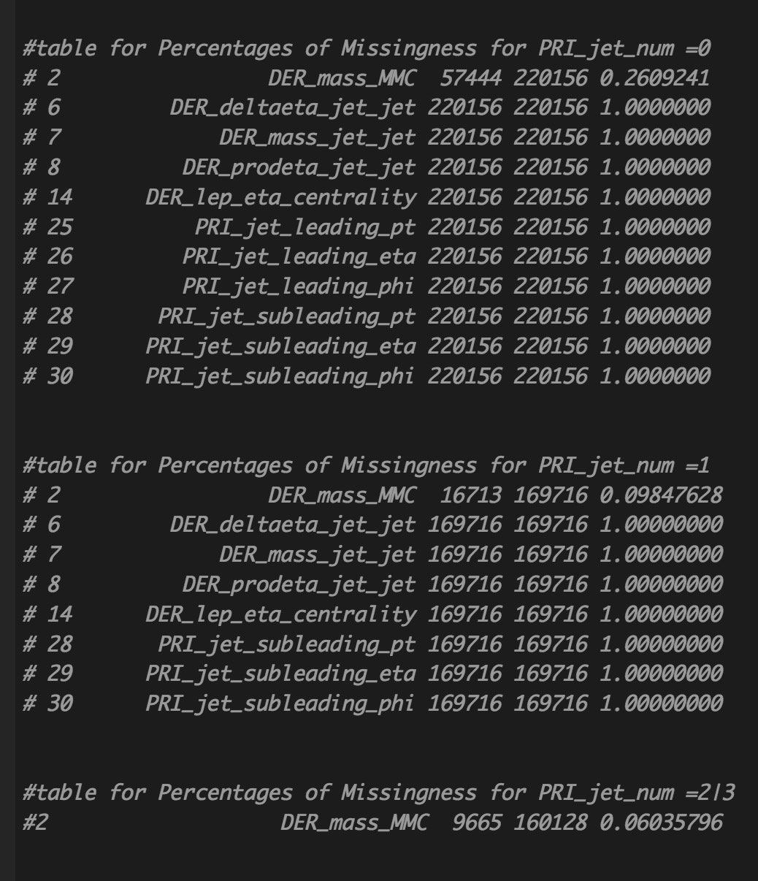
MISSINGNESS & PRI_jet_num
"DER_deltaeta_jet_jet"
"DER_mass_jet_jet"
"DER_prodeta_jet_jet"
"DER_lep_eta_centrality"
"PRI_jet_subleading_pt"
"PRI_jet_subleading_eta"
"PRI_jet_subleading_phi"
Gang of 7: 71% missing and always be missing together
"PRI_jet_leading_pt"
"PRI_jet_leading_eta"
"PRI_jet_leading_phi"
Gang of 3: 40% missing and always be missing together, only missing when gang of 7 are missing
"DER_mass_MMC":
15% missing and can be missing on its own

Slide 5
Random Forest
FEATURE
IMPORTANCE

Slide 6
PCA
SCREE plot

Slide 7
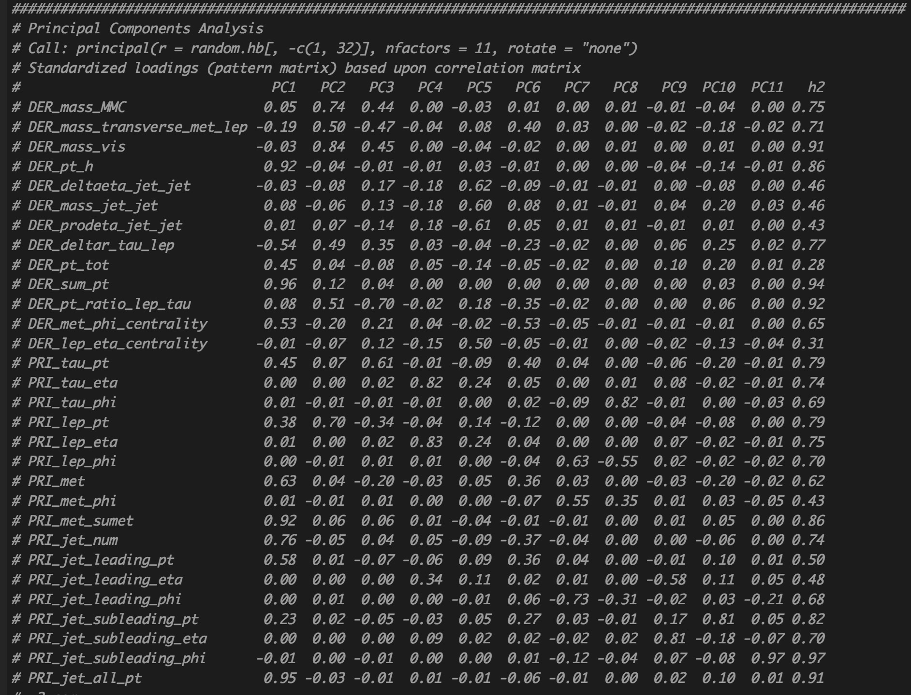
PCA
0.69 Cumulative Variance
Explained by 11 PCs, not
good enough for using
PCs to train model
All the variables are at least
Contributing to one of the
PCs
We can not dump variables
frivolously

Slide 8
EDA DATA DISTRIBUTION

Slide 9
EDA correlation

Slide 10
Work Flow
Raw Data
Subset by “PRI_jet_num”
0 1 2 & 3
Apply to Test Dataset:
Break test into: test_0 | test_1 | test_23
Plug into 3 ensemble models
Stack results into 1 submission file
Drop:
DER_deltaeta_jet_jet DER_mass_jet_jet DER_prodeta_jet_jet DER_lep_eta_centrality PRI_jet_leading_pt PRI_jet_leading_eta PRI_jet_leading_phi PRI_jet_subleading_pt PRI_jet_subleading_eta PRI_jet_subleading_phi
PRI_jet_num
PRI_jet_all_pt
DER_lep_eta_centrality DER_deltaeta_jet_jet DER_mass_jet_jet DER_prodeta_jet_jet PRI_jet_subleading_pt PRI_jet_subleading_eta PRI_jet_subleading_phi
None
Impute:
DER_mass_MMC
(0.26 missing)
DER_mass_MMC
(0.1 missing)
DER_mass_MMC
(0.061 missing)
Tune threshold respectively for
3 ensemble models
Tune
XGB
RF
Ada
For df0
Tune
XGB
RF
Ada
For df1
Tune
XGB
RF
Ada
For df23
Caret Stack
(using gbm):
ensemble_df0
ensemble_df1
ensemble_df23
Apply
Parameters
Caret_List
For df0
Apply
Parameters
Caret_List
For df1
Apply
Parameters
Caret_List
For df23

Slide 11
A couple of results: ADABOOST (iter=100, nu =.03, maxdepth = 10. Accuracy after threshold = 80%, Best threshold at p = 0.75 ) on the full raw dataset => AMS 3.45XGBOOST (usual parameters, accuracy after threshold 80%, ) => AMS 3.55ENSEMBLE: (ADABOOST + XGBOOST)/2 (average on predictions (unknown data) , averaged and then rounded. Threshold at p = 0.8) => AMS 3.57

